Slide 1
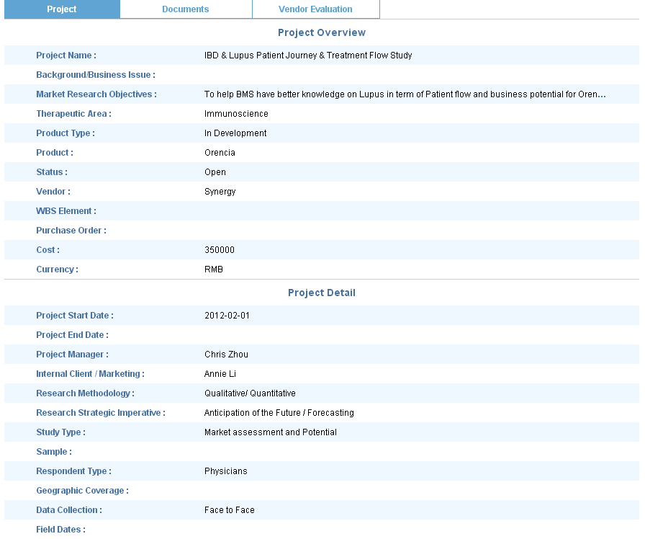
删除
删除
Study Type选项改为以下几项：
Awareness Trial Usage
Patient Journey
Sales Force Message Recall
Segmentation Targeting Positioning
Market Potential Assessment
Concept or DA Test
Market Access or Pricing
Competitive Intelligence
Other Types
删除
删除
删除

Slide 2
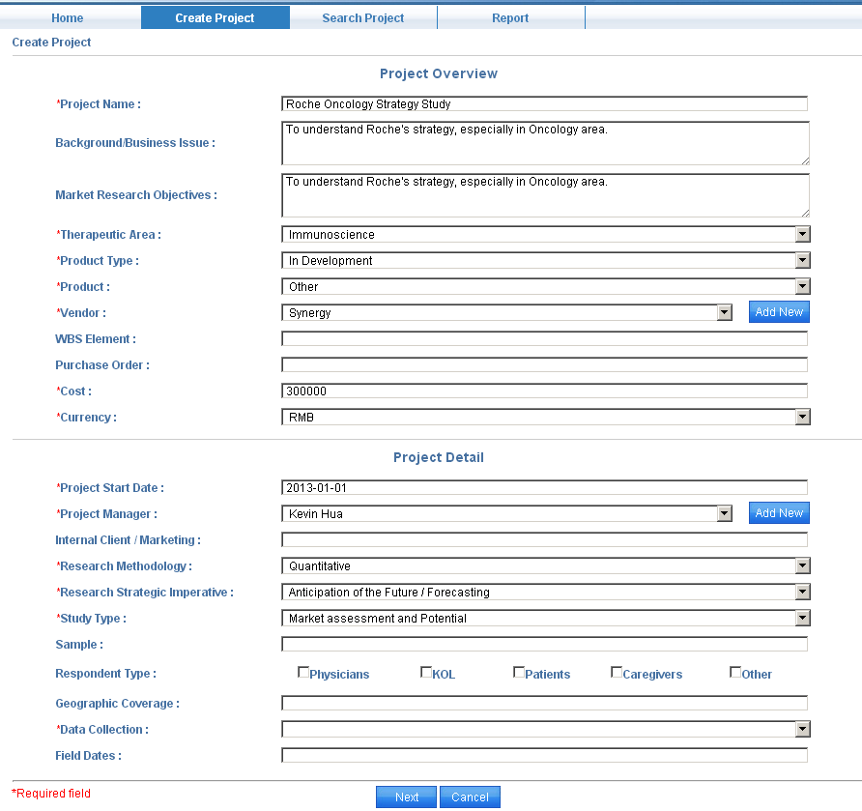
删除
增加Vendor 选项：
Rx-Consultant
删除
增加Project Manager选项：
Alan Wang
Study Type选项改为以下几项：
Awareness Trial Usage
Patient Journey
Sales Force Message Recall
Segmentation Targeting Positioning
Market Potential Assessment
Concept or DA Test
Market Access or Pricing
Competitive Intelligence
Other Types
删除
删除
删除

Slide 3
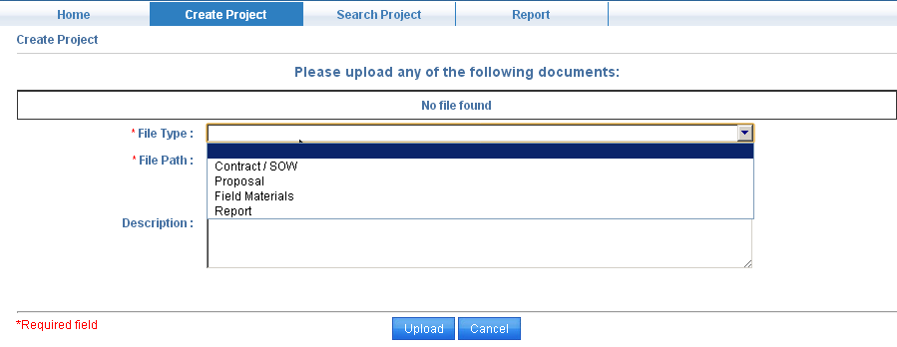
删除Contract / SOW选项
剩余3个选项改为：
Proposal
Research Materials
Project Delivery

Slide 4
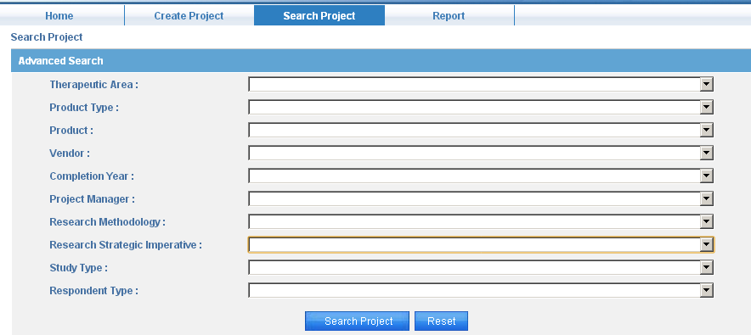
删除
删除

